Slide 1

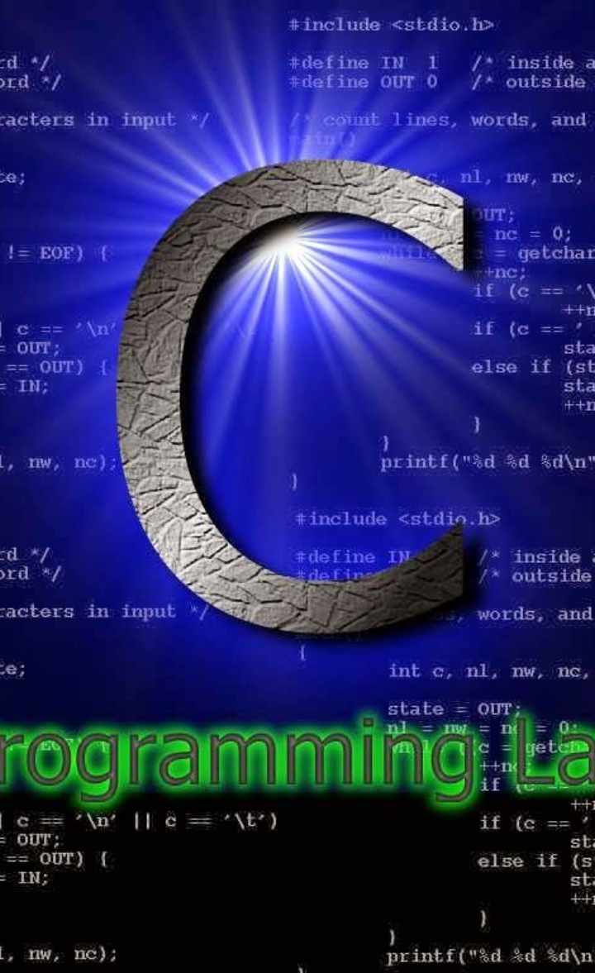

Introduction to Function Pointers
Function pointers in C are a powerful and unique feature that allows the creation of flexible and dynamic code. They play a crucial role in implementing callback mechanisms, polymorphism, and many other advanced programming techniques. Understanding function pointers is essential for mastering the C programming language and becoming a proficient developer. This comprehensive guide will explore the intricacies of function pointers, their syntax, applications, best practices, and potential pitfalls.
aa
by ahmad faisal

Slide 2
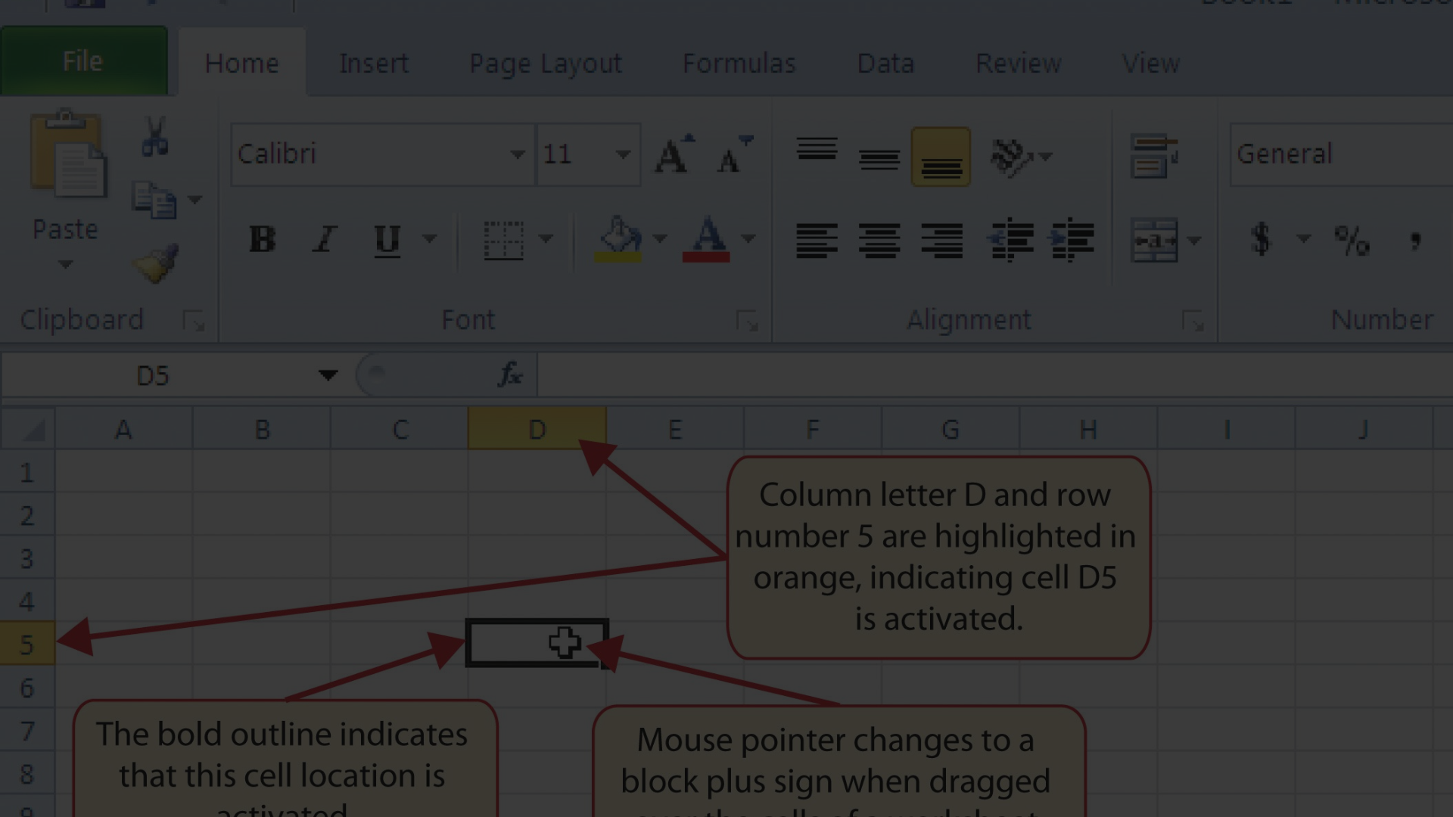
What are Function Pointers?
1
Definition
2
Key Characteristics
3
Usage in C
A function pointer in C is a variable that stores the address of a function.
They are extensively used in advanced C programming, especially when dealing with data structures and libraries.
Function pointers are used to call a function indirectly. They are commonly employed for implementing callbacks, polymorphism, and dynamic dispatch.

Slide 3
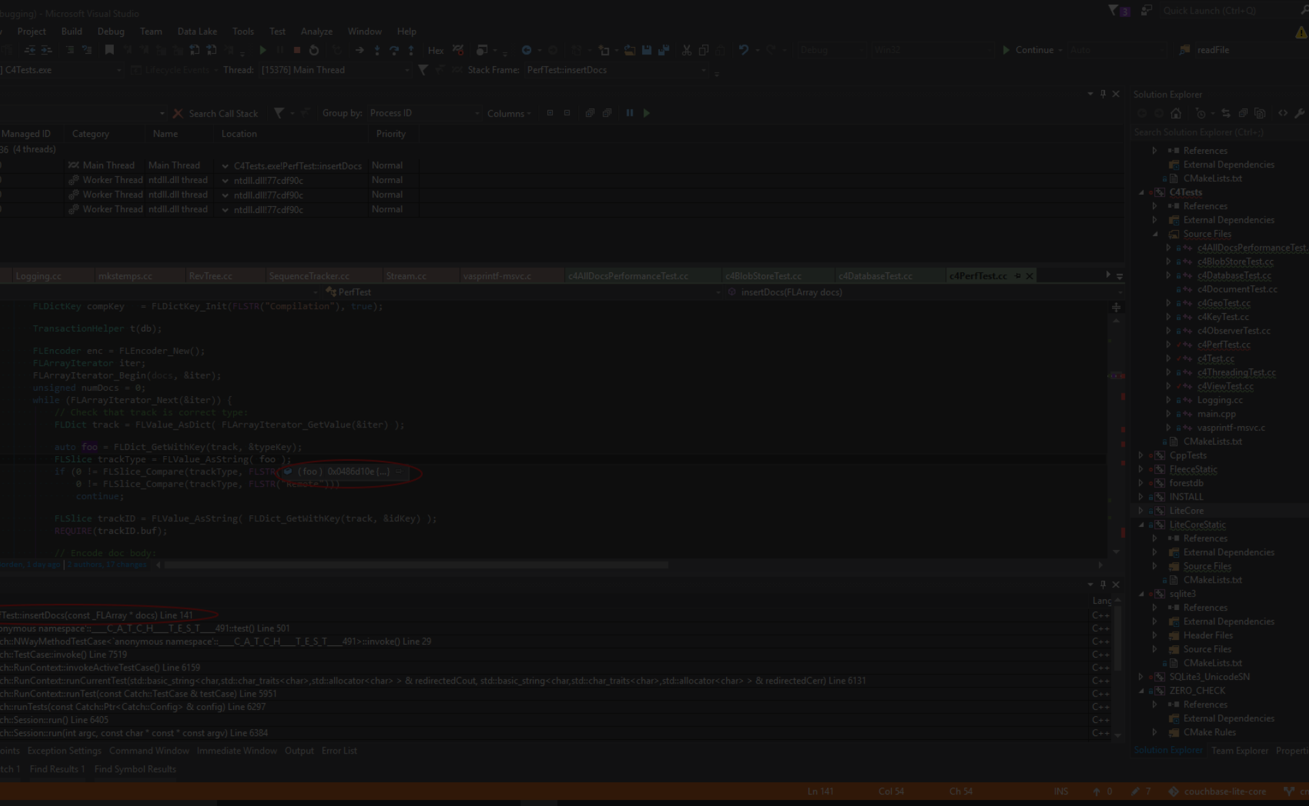
Syntax for Declaring and Using Function Pointers
1
Declaration
The syntax for declaring a function pointer involves specifying the return type of the function and the types of its parameters.
2
Initialization
A function pointer can be initialized with the address of a specific function, allowing indirect invocation of the function.
3
Invoking Functions
Using function pointers requires dereferencing the pointer to call the stored function.

Slide 4
Passing Function Pointers as Arguments
Flexible Function Calls
Callback Mechanisms
Enhanced Reusability
Passing function pointers as arguments enables the dynamic selection and invocation of functions, enhancing the flexibility of function calls.
This practice is widely used to implement callback functionalities, allowing functions to call back to other functions based on specific events or conditions.
It promotes code reusability by allowing different functions to be passed as arguments to other functions, enabling versatile functionality.

Slide 5
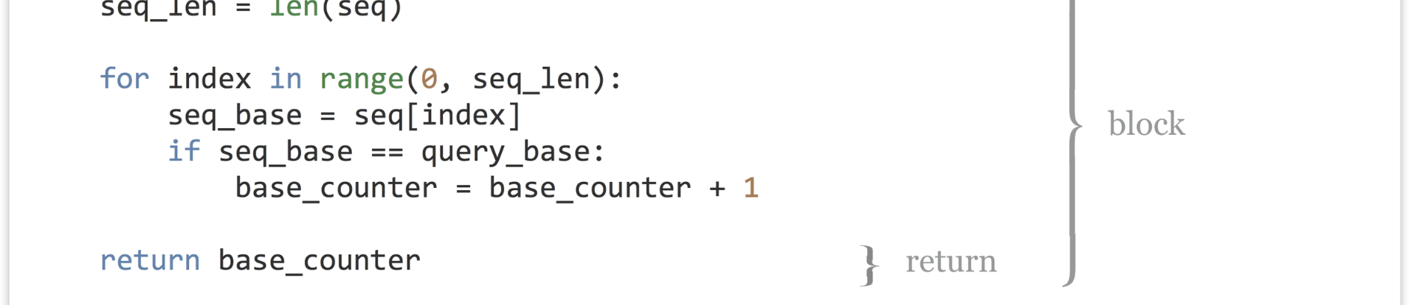



Returning Function Pointers from Functions
Dynamic Dispatch
Factory Functions
Polymorphism
Returning function pointers can facilitate dynamic dispatch, enabling the selection and invocation of different functions based on runtime conditions.
It allows factory functions to dynamically create and return specific functions based on input parameters, enhancing the flexibility of function creation.
Function pointers returned from functions can contribute to achieving polymorphic behavior, allowing for diverse implementations based on runtime needs.

Slide 6
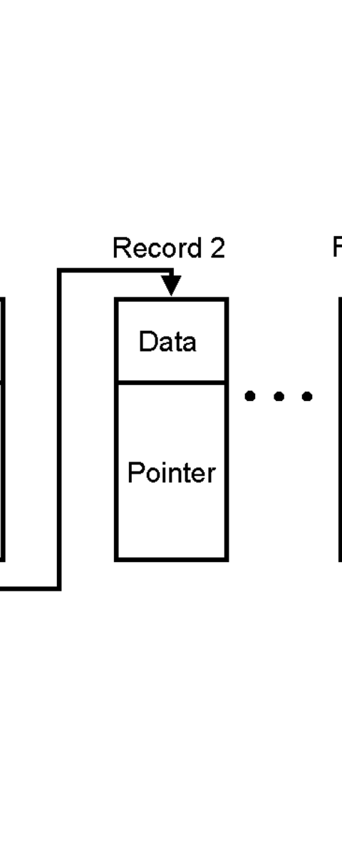
Use Cases for Function Pointers
Event Driven Systems
Sorting Algorithms
Function pointers are essential in sorting algorithms to enable customizable comparison functions for different data structures.
Implementing event-driven systems relies heavily on function pointers for callbacks during specific events or user interactions.
Plugin Architectures
Plugin-based architectures leverage function pointers for dynamically loading and invoking various functionalities within the system.

Slide 7
Advantages and Disadvantages of Using Function Pointers
1
Advantages
2
Disadvantages
Enables dynamic selection and invocation of functions. Enhances code modularity and flexibility.
Potential for complex pointer manipulation, leading to errors. Overuse can obscure code comprehension.

Slide 8

Common Mistakes and Pitfalls with Function Pointers
1
Improper Initialization
2
Memory Management
Incorrect initialization of function pointers can lead to runtime errors and unexpected behavior.
Improper memory handling when using function pointers can result in memory leaks and undefined behavior.
3
Type Mismatch
Mismatching function signatures when using function pointers can lead to segmentation faults and program crashes.

Slide 9
Best Practices for Using Function Pointers in C
1
Clear Documentation
2
Robust Error Handling
3
Validation Checks
Thoroughly document the intended usage of function pointers to ensure clarity for other developers.
Implement strong error handling mechanisms to gracefully manage unexpected behaviors when working with function pointers.
Always validate function pointers before invoking them to avoid null pointer dereferencing and associated issues.

Slide 10
Conclusion
1
2
3
Dynamic Functionality
Advanced Techniques
Enhanced Customization
Function pointers in C enable the dynamic invocation of functions, providing extensive flexibility in program design.
Mastering function pointers opens doors to advanced programming paradigms and techniques in the C language.
Utilizing function pointers allows for highly customizable and adaptive program architectures in C.

